Slide 1

Big Data Infrastructure
Session 4: Structured and Unstructured Data
Jimmy Lin
University of Maryland
Monday, February 16, 2015
This work is licensed under a Creative Commons Attribution-Noncommercial-Share Alike 3.0 United States See http://creativecommons.org/licenses/by-nc-sa/3.0/us/ for details

Slide 2
Today’s Agenda
Structured data
Processing relational data with MapReduce
Unstructured data
Basics of indexing and retrieval
Inverted indexing in MapReduce

Slide 3
Relational Databases
A relational database is comprised of tables
Each table represents a relation = collection of tuples (rows)
Each tuple consists of multiple fields

Slide 4
OLTP/OLAP Architecture
OLTP
OLAP
ETL (Extract, Transform, and Load)

Slide 5
OLTP/OLAP/Hadoop Architecture
OLTP
Hadoop
OLAP
ETL (Extract, Transform, and Load)

Slide 6
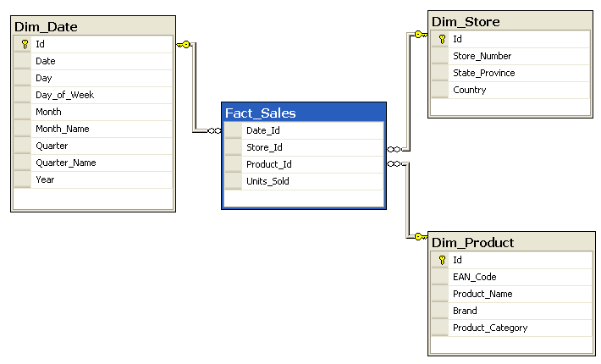
Structure of Data Warehouses
SELECT P.Brand, S.Country,
SUM(F.Units_Sold)
FROM Fact_Sales F
INNER JOIN Dim_Date D ON F.Date_Id = D.Id
INNER JOIN Dim_Store S ON F.Store_Id = S.Id
INNER JOIN Dim_Product P ON F.Product_Id = P.Id
WHERE D.YEAR = 1997 AND P.Product_Category = 'tv'
GROUP BY P.Brand, S.Country;
Source: Wikipedia (Star Schema)

Slide 7
OLAP Cubes
time
Common operations
slice and dice
roll up/drill down
pivot
product
store

Slide 8

MapReduce algorithms for processing relational data
Source: www.flickr.com/photos/stikatphotography/1590190676/

Slide 9

Source: www.flickr.com/photos/7518432@N06/2237536651/

Slide 10
Design Pattern: Secondary Sorting
MapReduce sorts input to reducers by key
Values are arbitrarily ordered
What if want to sort value also?
E.g., k → (v₁, r), (v₃, r), (v₄, r), (v₈, r)…

Slide 11
Secondary Sorting: Solutions
Solution 1:
Buffer values in memory, then sort
Why is this a bad idea?
Solution 2:
“Value-to-key conversion” design pattern: form composite intermediate key, (k, v₁)
Let execution framework do the sorting
Preserve state across multiple key-value pairs to handle processing
Anything else we need to do?

Slide 12
Value-to-Key Conversion
Before
k → (v₁, r), (v₄, r), (v₈, r), (v₃, r)…
Values arrive in arbitrary order…
After
(k, v₁) → (v₁, r)
Values arrive in sorted order…
(k, v₃) → (v₃, r)
Process by preserving state across multiple keys
(k, v₄) → (v₄, r)
Remember to partition correctly!
(k, v₈) → (v₈, r)
…

Slide 13
Working Scenario
Two tables:
User demographics (gender, age, income, etc.)
User page visits (URL, time spent, etc.)
Analyses we might want to perform:
Statistics on demographic characteristics
Statistics on page visits
Statistics on page visits by URL
Statistics on page visits by demographic characteristic
…

Slide 14
Relational Algebra
Primitives
Projection (π)
Selection (σ)
Cartesian product (×)
Set union (∪)
Set difference (−)
Rename (ρ)
Other operations
Join (⋈)
Group by… aggregation
…

Slide 15
Projection
R₁
R₁
R₂
R₂
R₃
R₃
R₄
R₄
R₅
R₅

Slide 16
Projection in MapReduce
Easy!
Map over tuples, emit new tuples with appropriate attributes
No reducers, unless for regrouping or resorting tuples
Alternatively: perform in reducer, after some other processing
Basically limited by HDFS streaming speeds
Speed of encoding/decoding tuples becomes important
Take advantage of compression when available
Semistructured data? No problem!

Slide 17
Selection
R₁
R₂
R₁
R₃
R₃
R₄
R₅

Slide 18
Selection in MapReduce
Easy!
Map over tuples, emit only tuples that meet criteria
No reducers, unless for regrouping or resorting tuples
Alternatively: perform in reducer, after some other processing
Basically limited by HDFS streaming speeds
Speed of encoding/decoding tuples becomes important
Take advantage of compression when available
Semistructured data? No problem!

Slide 19
Group by… Aggregation
Example: What is the average time spent per URL?
In SQL:
SELECT url, AVG(time) FROM visits GROUP BY url
In MapReduce:
Map over tuples, emit time, keyed by url
Framework automatically groups values by keys
Compute average in reducer
Optimize with combiners

Slide 20

Relational Joins
Source: Microsoft Office Clip Art

Slide 21
Relational Joins
R₁
S₁
R₂
S₂
R₃
S₃
R₄
S₄
R₁
S₂
R₂
S₄
R₃
S₁
R₄
S₃

Slide 22
Types of Relationships
Many-to-Many
One-to-Many
One-to-One

Slide 23
Join Algorithms in MapReduce
Reduce-side join
Map-side join
In-memory join
Striped variant
Memcached variant

Slide 24
Reduce-side Join
Basic idea: group by join key
Map over both sets of tuples
Emit tuple as value with join key as the intermediate key
Execution framework brings together tuples sharing the same key
Perform actual join in reducer
Similar to a “sort-merge join” in database terminology
Two variants
1-to-1 joins
1-to-many and many-to-many joins

Slide 25
Reduce-side Join: 1-to-1
Map
keys
values
R₁
R₁
R₄
R₄
S₂
S₂
S₃
S₃
Reduce
keys
values
R₁
S₂
S₃
R₄
Note: no guarantee if R is going to come first or S

Slide 26
Reduce-side Join: 1-to-many
Map
keys
values
R₁
R₁
S₂
S₂
S₃
S₃
S₉
S₉
Reduce
keys
values
R₁
S₂
S₃
…
What’s the problem?

Slide 27
Reduce-side Join: V-to-K Conversion
In reducer…
keys
values
R₁
New key encountered: hold in memory
S₂
Cross with records from other set
S₃
S₉
R₄
New key encountered: hold in memory
S₃
Cross with records from other set
S₇

Slide 28
Reduce-side Join: many-to-many
In reducer…
keys
values
R₁
R₅
Hold in memory
R₈
S₂
Cross with records from other set
S₃
S₉
What’s the problem?

Slide 29
Map-side Join: Basic Idea
Assume two datasets are sorted by the join key:
R₁
S₂
R₂
S₄
R₄
S₃
R₃
S₁
A sequential scan through both datasets to join (called a “merge join” in database terminology)

Slide 30
Map-side Join: Parallel Scans
If datasets are sorted by join key, join can be accomplished by a scan over both datasets
How can we accomplish this in parallel?
Partition and sort both datasets in the same manner
In MapReduce:
Map over one dataset, read from other corresponding partition
No reducers necessary (unless to repartition or resort)
Consistently partitioned datasets: realistic to expect?

Slide 31
In-Memory Join
Basic idea: load one dataset into memory, stream over other dataset
Works if R << S and R fits into memory
Called a “hash join” in database terminology
MapReduce implementation
Distribute R to all nodes
Map over S, each mapper loads R in memory, hashed by join key
For every tuple in S, look up join key in R
No reducers, unless for regrouping or resorting tuples

Slide 32
In-Memory Join: Variants
Striped variant:
R too big to fit into memory?
Divide R into R₁, R₂, R₃, … s.t. each R_{n} fits into memory
Perform in-memory join: ∀n, R_{n} ⋈ S
Take the union of all join results
Memcached join:
Load R into memcached
Replace in-memory hash lookup with memcached lookup

Slide 33
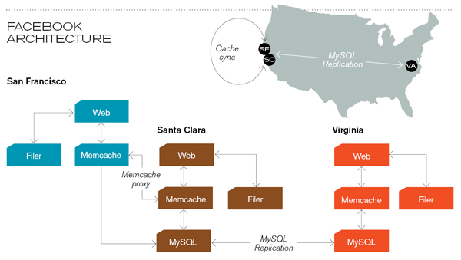
Memcached
Circa 2008 Architecture
Caching servers: 15 million requests per second, 95% handled by memcache (15 TB of RAM)
Database layer: 800 eight-core Linux servers running MySQL (40 TB user data)
Source: Technology Review (July/August, 2008)

Slide 34
Memcached Join
Memcached join:
Load R into memcached
Replace in-memory hash lookup with memcached lookup
Capacity and scalability?
Memcached capacity >> RAM of individual node
Memcached scales out with cluster
Latency?
Memcached is fast (basically, speed of network)
Batch requests to amortize latency costs
Source: See tech report by Lin et al. (2009)

Slide 35
Which join to use?
In-memory join > map-side join > reduce-side join
Why?
Limitations of each?
In-memory join: memory
Map-side join: sort order and partitioning
Reduce-side join: general purpose

Slide 36
Processing Relational Data: Summary
MapReduce algorithms for processing relational data:
Group by, sorting, partitioning are handled automatically by shuffle/sort in MapReduce
Selection, projection, and other computations (e.g., aggregation), are performed either in mapper or reducer
Multiple strategies for relational joins
Complex operations require multiple MapReduce jobs
Example: top ten URLs in terms of average time spent
Opportunities for automatic optimization

Slide 37
Source: www.flickr.com/photos/7518432@N06/2237536651/

Slide 38
Today’s Agenda
Structured data
Processing relational data with MapReduce
Unstructured data
Basics of indexing and retrieval
Inverted indexing in MapReduce

Slide 39
First, nomenclature…
Information retrieval (IR)
Focus on textual information (= text/document retrieval)
Other possibilities include image, video, music, …
What do we search?
Generically, “collections”
Less-frequently used, “corpora”
What do we find?
Generically, “documents”
Even though we may be referring to web pages, PDFs, PowerPoint slides, paragraphs, etc.

Slide 40
Information Retrieval Cycle
Source
Selection
Resource
Query
Formulation
Query
Search
Results
Selection
Documents
System discovery
Vocabulary discovery
Concept discovery
Document discovery
Examination
Information
source reselection
Delivery

Slide 41
The Central Problem in Search
Author
Searcher
Concepts
Concepts
Query Terms
Document Terms
“tragic love story”
“fateful star-crossed romance”
Do these represent the same concepts?
Notes:
Why is IR hard? Because language is hard!

Slide 42
Abstract IR Architecture
Documents
Query
document acquisition (e.g., web crawling)
online
offline
Representation
Function
Representation
Function
Query Representation
Document Representation
Index
Comparison
Function
Hits

Slide 43
How do we represent text?
Remember: computers don’t “understand” anything!
“Bag of words”
Treat all the words in a document as index terms
Assign a “weight” to each term based on “importance” (or, in simplest case, presence/absence of word)
Disregard order, structure, meaning, etc. of the words
Simple, yet effective!
Assumptions
Term occurrence is independent
Document relevance is independent
“Words” are well-defined

Slide 44
What’s a word?
天主教教宗若望保祿二世因感冒再度住進醫院。這是他今年第二度因同樣的病因住院。
وقال مارك ريجيف - الناطق باسم
الخارجية الإسرائيلية - إن شارون قبل
الدعوة وسيقوم للمرة الأولى بزيارة
تونس، التي كانت لفترة طويلة المقر
الرسمي لمنظمة التحرير الفلسطينية بعد خروجها من لبنان عام 1982.
Выступая в Мещанском суде Москвы экс-глава ЮКОСа заявил не совершал ничего противозаконного, в чем обвиняет его генпрокуратура России.
भारत सरकार ने आर्थिक सर्वेक्षण में वित्तीय वर्ष 2005-06 में सात फ़ीसदी विकास दर हासिल करने का आकलन किया है और कर सुधार पर ज़ोर दिया है
日米連合で台頭中国に対処…アーミテージ前副長官提言
조재영 기자= 서울시는 25일 이명박 시장이 `행정중심복합도시'' 건설안에 대해 `군대라도 동원해 막고싶은 심정''이라고 말했다는 일부 언론의 보도를 부인했다.

Slide 45
Sample Document
McDonald's slims down spuds
Fast-food chain to reduce certain types of fat in its french fries with new cooking oil.
NEW YORK (CNN/Money) - McDonald's Corp. is cutting the amount of "bad" fat in its french fries nearly in half, the fast-food chain said Tuesday as it moves to make all its fried menu items healthier.
But does that mean the popular shoestring fries won't taste the same? The company says no. "It's a win-win for our customers because they are getting the same great french-fry taste along with an even healthier nutrition profile," said Mike Roberts, president of McDonald's USA.
But others are not so sure. McDonald's will not specifically discuss the kind of oil it plans to use, but at least one nutrition expert says playing with the formula could mean a different taste.
Shares of Oak Brook, Ill.-based McDonald's (MCD: down $0.54 to $23.22, Research, Estimates) were lower Tuesday afternoon. It was unclear Tuesday whether competitors Burger King and Wendy's International (WEN: down $0.80 to $34.91, Research, Estimates) would follow suit. Neither company could immediately be reached for comment.
…
“Bag of Words”
14 × McDonalds
12 × fat
11 × fries
8 × new
7 × french
6 × company, said, nutrition
5 × food, oil, percent, reduce, taste, Tuesday
…

Slide 46
Counting Words…
Documents
case folding, tokenization, stopword removal, stemming
Bag of Words
syntax, semantics, word knowledge, etc.
Inverted
Index

Slide 47
Boolean Retrieval
Users express queries as a Boolean expression
AND, OR, NOT
Can be arbitrarily nested
Retrieval is based on the notion of sets
Any given query divides the collection into two sets: retrieved, not-retrieved
Pure Boolean systems do not define an ordering of the results

Slide 48
Inverted Index: Boolean Retrieval
Doc 1
Doc 2
Doc 3
Doc 4
one fish, two fish
red fish, blue fish
cat in the hat
green eggs and ham
1
2
3
4
blue
1
blue
2
cat
1
cat
3
egg
1
egg
4
fish
1
1
fish
1
2
green
1
green
4
ham
1
ham
4
hat
1
hat
3
one
1
one
1
red
1
red
2
two
1
two
1

Slide 49
Boolean Retrieval
To execute a Boolean query:
Build query syntax tree
For each clause, look up postings
Traverse postings and apply Boolean operator
Efficiency analysis
Postings traversal is linear (assuming sorted postings)
Start with shortest posting first
OR
( blue AND fish ) OR ham
ham
AND
blue
fish
blue
2
fish
1
2

Slide 50
Strengths and Weaknesses
Strengths
Precise, if you know the right strategies
Precise, if you have an idea of what you’re looking for
Implementations are fast and efficient
Weaknesses
Users must learn Boolean logic
Boolean logic insufficient to capture the richness of language
No control over size of result set: either too many hits or none
When do you stop reading? All documents in the result set are considered “equally good”
What about partial matches? Documents that “don’t quite match” the query may be useful also

Slide 51
Ranked Retrieval
Order documents by how likely they are to be relevant
Estimate relevance(q, d_{i})
Sort documents by relevance
Display sorted results
User model
Present hits one screen at a time, best results first
At any point, users can decide to stop looking
How do we estimate relevance?
Assume document is relevant if it has a lot of query terms
Replace relevance(q, d_{i}) with sim(q, d_{i})
Compute similarity of vector representations

Slide 52
Vector Space Model
t₃
d₂
d₃
d₁
θ
φ
t₁
d₅
t₂
d₄
Assumption: Documents that are “close together” in vector space “talk about” the same things
Therefore, retrieve documents based on how close the document is to the query (i.e., similarity ~ “closeness”)

Slide 53
Similarity Metric
Use “angle” between the vectors:
Or, more generally, inner products:

Slide 54
Term Weighting
Term weights consist of two components
Local: how important is the term in this document?
Global: how important is the term in the collection?
Here’s the intuition:
Terms that appear often in a document should get high weights
Terms that appear in many documents should get low weights
How do we capture this mathematically?
Term frequency (local)
Inverse document frequency (global)

Slide 55
TF.IDF Term Weighting
weight assigned to term i in document j
number of occurrence of term i in document j
number of documents in entire collection
number of documents with term i

Slide 56
Inverted Index: TF.IDF
Doc 1
Doc 2
Doc 3
Doc 4
one fish, two fish
red fish, blue fish
cat in the hat
green eggs and ham
tf
1
2
3
4
df
blue
1
1
blue
1
2
1
cat
1
1
cat
1
3
1
egg
1
1
egg
1
4
1
fish
2
2
2
fish
2
1
2
2
2
green
1
1
green
1
4
1
ham
1
1
ham
1
4
1
hat
1
1
hat
1
3
1
one
1
1
one
1
1
1
red
1
1
red
1
2
1
two
1
1
two
1
1
1

Slide 57
Positional Indexes
Store term position in postings
Supports richer queries (e.g., proximity)
Naturally, leads to larger indexes…

Slide 58
Inverted Index: Positional Information
Doc 1
Doc 2
Doc 3
Doc 4
one fish, two fish
red fish, blue fish
cat in the hat
green eggs and ham
tf
1
2
3
4
df
blue
1
1
blue
1
2
1
[3]
cat
1
1
cat
1
3
1
[1]
egg
1
1
egg
1
4
1
[2]
fish
2
2
2
fish
2
1
2
[2,4]
2
2
[2,4]
green
1
1
green
1
4
1
[1]
ham
1
1
ham
1
4
1
[3]
hat
1
1
hat
1
3
1
[2]
one
1
1
one
1
1
1
[1]
red
1
1
red
1
2
1
[1]
two
1
1
two
1
1
1
[3]

Slide 59
Retrieval in a Nutshell
Look up postings lists corresponding to query terms
Traverse postings for each query term
Store partial query-document scores in accumulators
Select top k results to return

Slide 60
Retrieval: Document-at-a-Time
Evaluate documents one at a time (score all query terms)
Tradeoffs
Small memory footprint (good)
Skipping possible to avoid reading all postings (good)
More seeks and irregular data accesses (bad)
blue
9
2
21
1
35
1
…
fish
1
2
9
1
21
3
34
1
35
2
80
3
…
Accumulators
(e.g. min heap)
Document score in top k?
Yes: Insert document score, extract-min if heap too large
No: Do nothing

Slide 61
Retrieval: Query-At-A-Time
Evaluate documents one query term at a time
Usually, starting from most rare term (often with tf-sorted postings)
Tradeoffs
Early termination heuristics (good)
Large memory footprint (bad), but filtering heuristics possible
blue
9
2
21
1
35
1
…
Accumulators (e.g., hash)
Score_{{q=x}}(doc n) = s
fish
1
2
9
1
21
3
34
1
35
2
80
3
…

Slide 62
MapReduce it?
The indexing problem
Scalability is critical
Must be relatively fast, but need not be real time
Fundamentally a batch operation
Incremental updates may or may not be important
For the web, crawling is a challenge in itself
The retrieval problem
Must have sub-second response time
For the web, only need relatively few results
Perfect for MapReduce!
Uh… not so good…

Slide 63
Indexing: Performance Analysis
Fundamentally, a large sorting problem
Terms usually fit in memory
Postings usually don’t
How is it done on a single machine?
How can it be done with MapReduce?
First, let’s characterize the problem size:
Size of vocabulary
Size of postings

Slide 64
Vocabulary Size: Heaps’ Law
Heaps’ Law: linear in log-log space
Vocabulary size grows unbounded!
M is vocabulary size
T is collection size (number of documents)
k and b are constants
Typically, k is between 30 and 100, b is between 0.4 and 0.6
Notes:
22

Slide 65
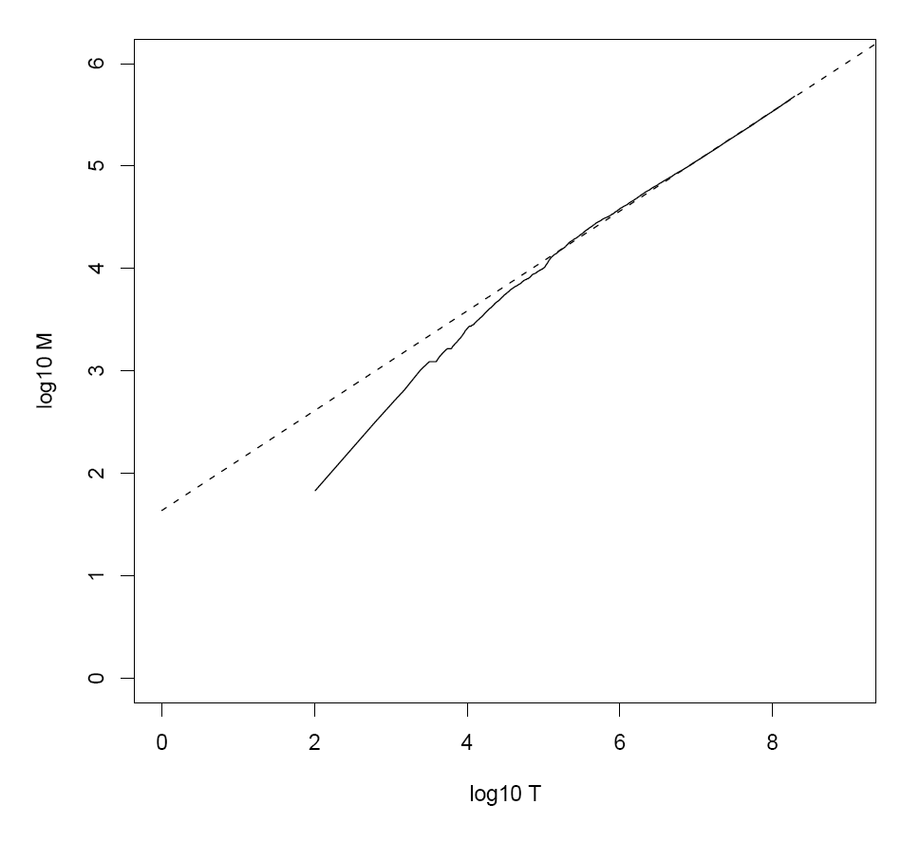
Heaps’ Law for RCV1
k = 44
b = 0.49
First 1,000,020 terms:
Predicted = 38,323
Actual = 38,365
Reuters-RCV1 collection: 806,791 newswire documents (Aug 20, 1996-August 19, 1997)
Manning, Raghavan, Schütze, Introduction to Information Retrieval (2008)

Slide 66
Postings Size: Zipf’s Law
Zipf’s Law: (also) linear in log-log space
Specific case of Power Law distributions
In other words:
A few elements occur very frequently
Many elements occur very infrequently
cf is the collection frequency of i-th common term
c is a constant
Notes:
22

Slide 67
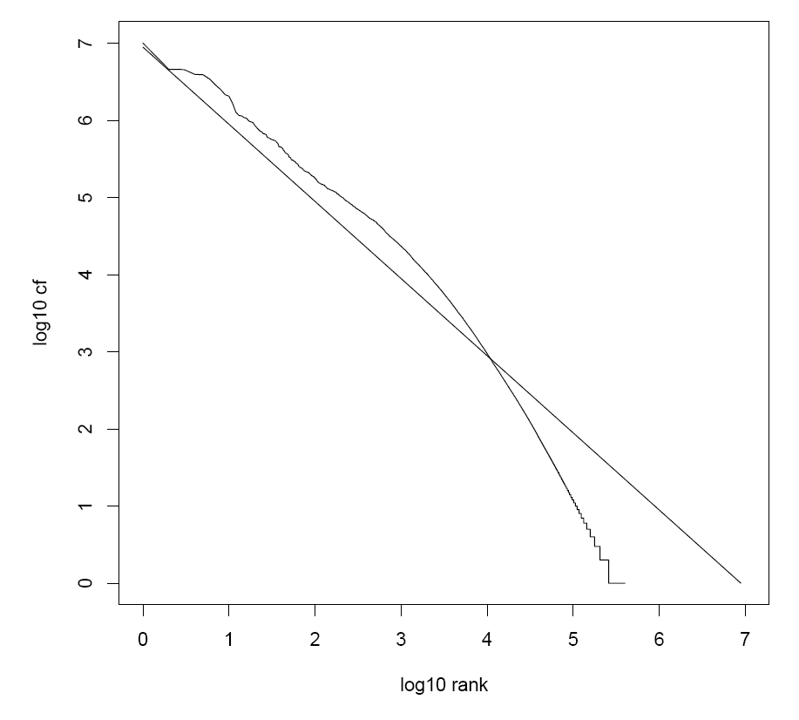
Zipf’s Law for RCV1
Fit isn’t that good… but good enough!
Reuters-RCV1 collection: 806,791 newswire documents (Aug 20, 1996-August 19, 1997)
Manning, Raghavan, Schütze, Introduction to Information Retrieval (2008)

Slide 68
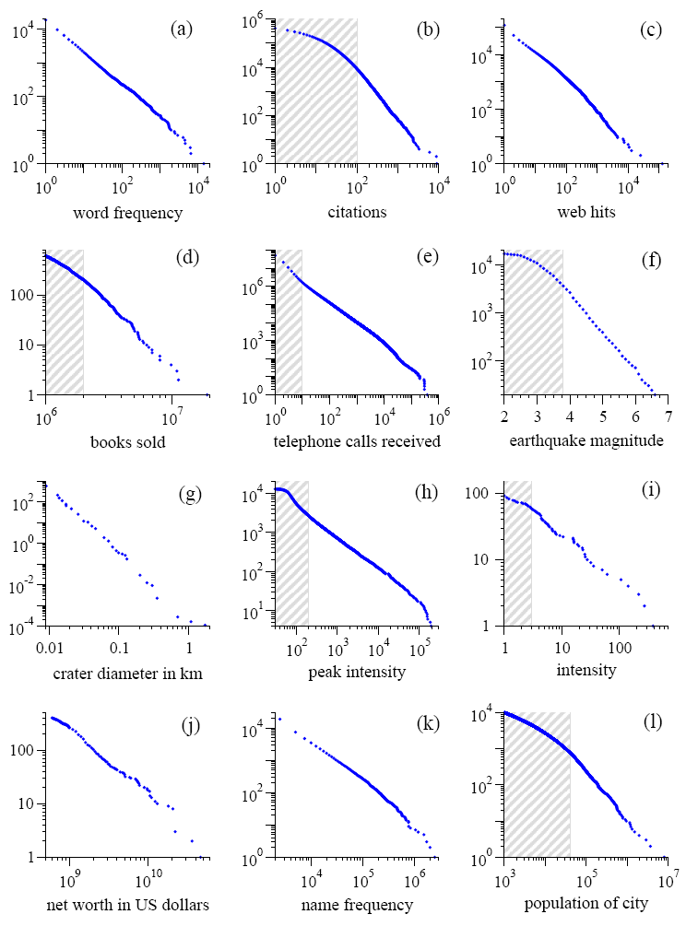
Power Laws are everywhere!
Figure from: Newman, M. E. J. (2005) “Power laws, Pareto distributions and Zipf's law.” Contemporary Physics 46:323–351.

Slide 69
MapReduce: Index Construction
Map over all documents
Emit term as key, (docno, tf) as value
Emit other information as necessary (e.g., term position)
Sort/shuffle: group postings by term
Reduce
Gather and sort the postings (e.g., by docno or tf)
Write postings to disk
MapReduce does all the heavy lifting!

Slide 70
Inverted Indexing with MapReduce
Doc 1
Doc 2
Doc 3
one fish, two fish
red fish, blue fish
cat in the hat
one
1
1
red
2
1
cat
3
1
Map
two
blue
hat
1
1
2
1
3
1
fish
1
2
fish
2
2
Shuffle and Sort: aggregate values by keys
cat
3
1
Reduce
blue
2
1
fish
1
2
2
2
hat
3
1
one
1
1
two
1
1
red
2
1

Slide 71
Inverted Indexing: Pseudo-Code

Slide 72
Positional Indexes
Doc 1
Doc 2
Doc 3
one fish, two fish
red fish, blue fish
cat in the hat
one
1
1
[1]
red
2
1
[1]
cat
3
1
[1]
Map
two
blue
hat
1
1
[3]
2
1
[3]
3
1
[2]
fish
1
2
[2,4]
fish
2
2
[2,4]
Shuffle and Sort: aggregate values by keys
cat
3
1
[1]
Reduce
blue
2
1
[3]
fish
1
2
[2,4]
2
2
[2,4]
hat
3
1
[2]
one
1
1
[1]
two
1
1
[3]
red
2
1
[1]

Slide 73
Inverted Indexing: Pseudo-Code
What’s the problem?

Slide 74
Scalability Bottleneck
Initial implementation: terms as keys, postings as values
Reducers must buffer all postings associated with key (to sort)
What if we run out of memory to buffer postings?
Uh oh!

Slide 75
Another Try…
(key)
(values)
(keys)
(values)
fish
1
2
[2,4]
fish
1
[2,4]
34
1
[23]
fish
9
[9]
21
3
[1,8,22]
fish
21
[1,8,22]
35
2
[8,41]
fish
34
[23]
80
3
[2,9,76]
fish
35
[8,41]
9
1
[9]
fish
80
[2,9,76]
How is this different?
Let the framework do the sorting
Term frequency implicitly stored
Where have we seen this before?

Slide 76
Inverted Indexing: Pseudo-Code

Slide 77
Inverted Index (Again)
Doc 1
Doc 2
Doc 3
Doc 4
one fish, two fish
red fish, blue fish
cat in the hat
green eggs and ham
tf
1
2
3
4
df
blue
1
1
blue
1
2
1
cat
1
1
cat
1
3
1
egg
1
1
egg
1
4
1
fish
2
2
2
fish
2
1
2
2
2
green
1
1
green
1
4
1
ham
1
1
ham
1
4
1
hat
1
1
hat
1
3
1
one
1
1
one
1
1
1
red
1
1
red
1
2
1
two
1
1
two
1
1
1

Slide 78
Chicken and Egg?
(key)
(value)
fish
1
[2,4]
fish
9
[9]
We’d like to store the df at the front of the postings list
fish
21
[1,8,22]
fish
34
[23]
But we don’t know the df until we’ve seen all postings!
fish
35
[8,41]
fish
80
[2,9,76]
…
Write postings
Sound familiar?

Slide 79
Getting the df
In the mapper:
Emit “special” key-value pairs to keep track of df
In the reducer:
Make sure “special” key-value pairs come first: process them to determine df
Remember: proper partitioning!

Slide 80
Getting the df: Modified Mapper
Doc 1
one fish, two fish
Input document…
(key)
(value)
fish
1
[2,4]
Emit normal key-value pairs…
one
1
[1]
two
1
[3]
fish
★
[1]
Emit “special” key-value pairs to keep track of df…
one
★
[1]
two
★
[1]

Slide 81
Getting the df: Modified Reducer
(key)
(value)
fish
★
[63]
[82]
[27]
…
First, compute the df by summing contributions from all “special” key-value pair…
Write the df…
fish
1
[2,4]
fish
9
[9]
fish
21
[1,8,22]
Important: properly define sort order to make sure “special” key-value pairs come first!
fish
34
[23]
fish
35
[8,41]
fish
80
[2,9,76]
…
Write postings
Where have we seen this before?

Slide 82
Postings Encoding
Conceptually:
fish
1
2
9
1
21
3
34
1
35
2
80
3
…
In Practice:
Don’t encode docnos, encode gaps (or d-gaps)
But it’s not obvious that this save space…
fish
1
2
8
1
12
3
13
1
1
2
45
3
…

Slide 83
Overview of Index Compression
Byte-aligned vs. bit-aligned
Byte-aligned technique
VByte
Simple9 and variants
PForDelta
Bit-aligned
Unary codes
γ codes
δ codes
Golomb codes (local Bernoulli model)
Want more detail? Read Managing Gigabytes by Witten, Moffat, and Bell!

Slide 84
VByte
Simple idea: use only as many bytes as needed
Need to reserve one bit per byte as the “continuation bit”
Use remaining bits for encoding value
Works okay, easy to implement…
7 bits
0
14 bits
1
0
21 bits
1
1
0

Slide 85
Inverted Indexing: IP
What’s the assumption?

Slide 86
Inverted Indexing: LP

Slide 87
Inverted Indexing: LP

Slide 88
MapReduce it?
The indexing problem
Scalability is paramount
Must be relatively fast, but need not be real time
Fundamentally a batch operation
Incremental updates may or may not be important
For the web, crawling is a challenge in itself
The retrieval problem
Must have sub-second response time
For the web, only need relatively few results
Just covered
Now

Slide 89
Retrieval with MapReduce?
MapReduce is fundamentally batch-oriented
Optimized for throughput, not latency
Startup of mappers and reducers is expensive
MapReduce is not suitable for real-time queries!
Use separate infrastructure for retrieval…

Slide 90
Important Ideas
Partitioning (for scalability)
Replication (for redundancy)
Caching (for speed)
Routing (for load balancing)
The rest is just details!

Slide 91
Term vs. Document Partitioning
D
T₁
D
T₂
Term Partitioning
…
T₃
T
Document Partitioning
…
T
D₁
D₂
D₃

Slide 92
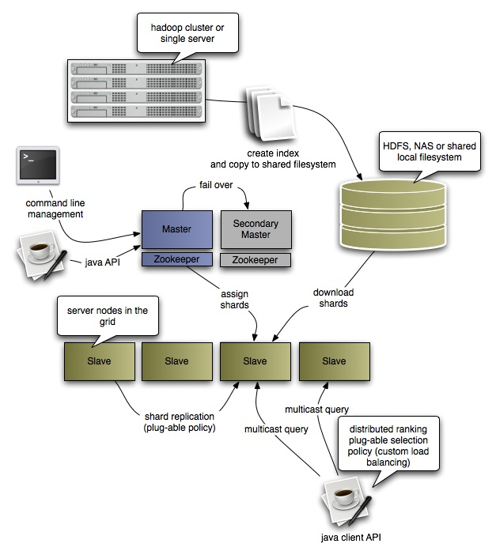
Katta Architecture (Distributed Lucene)
http://katta.sourceforge.net/

Slide 93

Questions?
Source: Wikipedia (Japanese rock garden)

